Slide 1
Reinforcement Learning Daniel Acuna acuna.io

Slide 2
What is Reinforcement Learning
Recent news coverage has highlighted how reinforcement learning algorithms are now beating professionals in games like GO, Dota 2, and Starcraft 2.
Reinforcement learning is a type of machine learning that enables the use of artificial intelligence in complex applications from video games to robotics, self-driving cars, and more.
mathworks.com

Slide 3
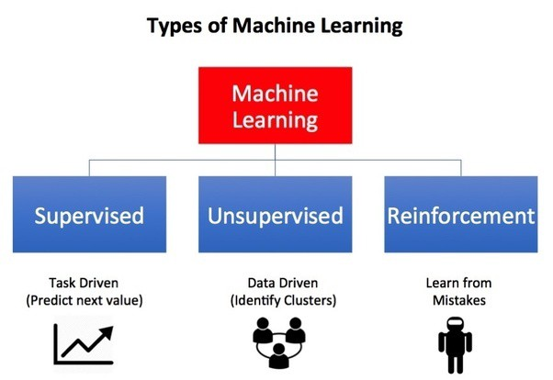
How is Reinforcement Learning Different?
Reinforcement Learning(RL) is a type of machine learning technique that enables an agent to learn in an interactive environment by trial and error using feedback from its own actions and experiences.
https://towardsdatascience.com/reinforcement-learning-101-e24b50e1d292

Slide 4

How does Reinforcement Leaning Work ?
The goal in unsupervised learning is to find similarities and differences between data points
The goal of reinforcement learning is to find a suitable action model that would maximize the total cumulative reward of the agent.
https://cs.stanford.edu/people/karpathy/convnetjs/demo/rldemo.html
https://towardsdatascience.com/reinforcement-learning-101-e24b50e1d292

Slide 5
How does Reinforcement Leaning Work ?
Activity #1: In the following demo:
https://cs.stanford.edu/people/karpathy/convnetjs/demo/rldemo.html
1. What is the enviornment?
2. What is the agent?
3. What are the actions?
4. What is the state?
5. What are the rewards?
https://towardsdatascience.com/reinforcement-learning-101-e24b50e1d292

Slide 6
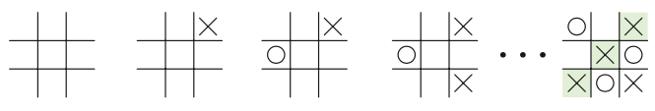
Formalizing Reinforcement Learning
Tic-tac-toe

Slide 7
Formalizing Reinforcement Learning
Tic-tac-toe
T
We can describe the sequence of events of a system by its sequence of states
s₁, s₂, s₃, …, s_{T}

Slide 8
Formalizing Reinforcement Learning
Tic-tac-toe
T
If we observe many millions of players play, we could estimate the probability of observing any sequence of T steps
p(s₁, s₂, s₃, …, s_{T})

Slide 9
Formalizing Reinforcement Learning
T = 3
How big is the probability distribution of three steps?
p(s₁, s₂, s₃)

Slide 10
Formalizing Reinforcement Learning
T = 3
How big is the probability distribution of three steps?
p(s₁, s₂, s₃)
What is the cardinality of a state s?
What is the cardinality of the joint distribution?
Are there some optimizations that we can apply to the joint distribution?

Slide 11
Formalizing RL: key insight
T = 3
When thinking about time events, sometimes we do not need to thinkin about the past. Transition dynamics sometimes do not depend on when they happen
p(s_{next} |s_{now}= )
examples?

Slide 12
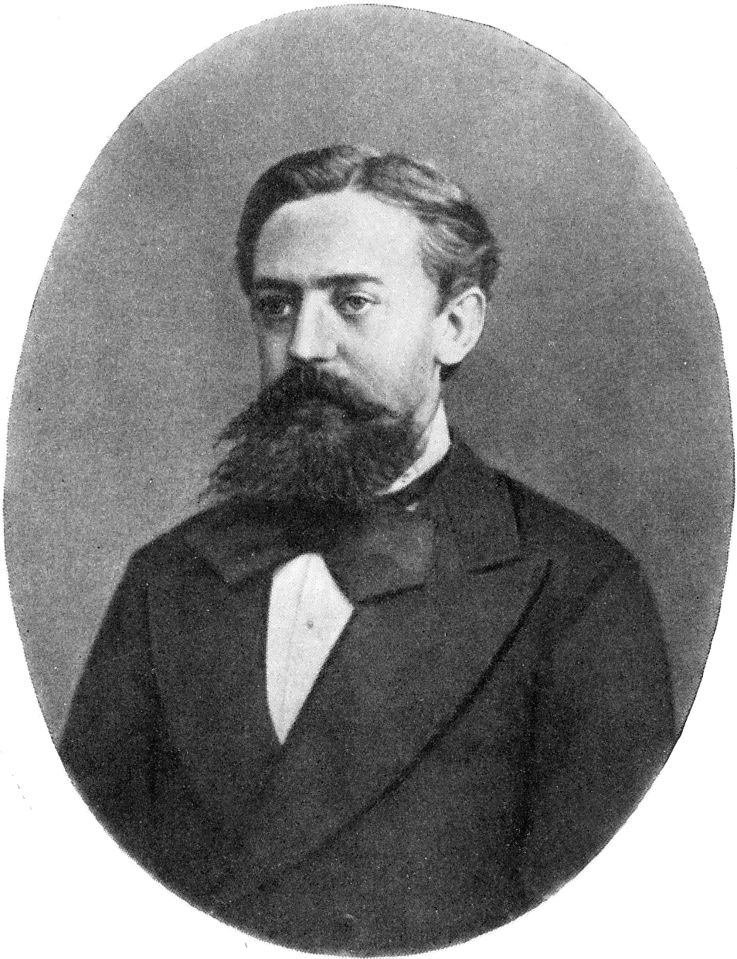
Markov Chains: Theory
State space models: we can specificy the transition dynamics of a system
Andrey Markov

Slide 13
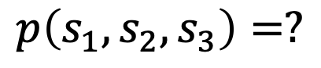
Markov Chains: Theory
State space models: we can specificy the transition dynamics of a system
p(s_{t+1}| s_{t})
how can we efficiently represent this?
s_{t}
s_{t+1}
$$p\left(s_{1},s_{2},s_{3}\right)=?$$
current state
next state
s_{t}
: state at time t
https://towardsdatascience.com/markov-chain-analysis-and-simulation-using-python-4507cee0b06e

Slide 14
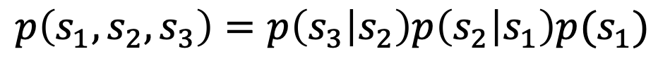
Markov Chains: Theory
State space models: we can specificy the transition dynamics of a system
p(s_{t+1}| s_{t})
how can we efficiently represent this?
s_{t}
s_{t+1}
$$p\left(s_{1},s_{2},s_{3}\right)=p\left(s_{3} | s_{2}\right)p\left(s_{2} | s_{1}\right)p(s_{1})$$
current state
next state
s_{t}
: state at time t
https://towardsdatascience.com/markov-chain-analysis-and-simulation-using-python-4507cee0b06e

Slide 15
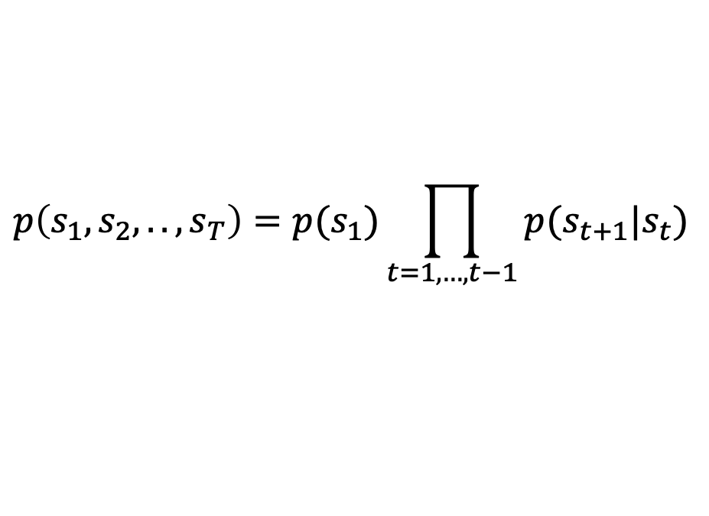
Markov Chains: Theory
State space models: we can specificy the transition dynamics of a system
p(s_{t+1}| s_{t})
In general:
s_{t}
s_{t+1}
$$p\left(s_{1},s_{2},..,s_{T}\right)=p(s_{1})\prod_{t=1,…,t−1}{p(s_{t+1}|s_{t})}$$
current state
next state
s_{t}
: state at time t
https://towardsdatascience.com/markov-chain-analysis-and-simulation-using-python-4507cee0b06e

Slide 16
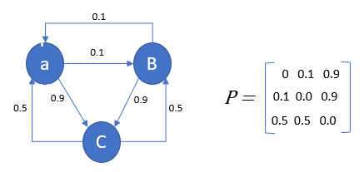
Markov Chains: Theory
State space models
p(s_{t+1}| s_{t})
s_{t}
s_{t+1}
current state
next state
s_{t}
: state at time t
https://towardsdatascience.com/markov-chain-analysis-and-simulation-using-python-4507cee0b06e

Slide 17
Markov Chains: Theory
State space models
p(s_{t+1}| s_{t})
p(s_{t+1}= a| s_{t} = a) = ?
s_{t}
s_{t+1}
p(s_{t+1}= b| s_{t} = a) = ?
p(s_{t+1}= c| s_{t} = a) = ?
current state
next state
s_{t}
: state at time t
https://towardsdatascience.com/markov-chain-analysis-and-simulation-using-python-4507cee0b06e

Slide 18
Markov Chains: Theory
State space models: we can represent the transition distribution as a matrix
next state
current state
https://towardsdatascience.com/markov-chain-analysis-and-simulation-using-python-4507cee0b06e

Slide 19
Markov Chains: Theory
State space models: we can represent the transition distribution as a matrix
next state
And we can reason about any chain length
current state
https://towardsdatascience.com/markov-chain-analysis-and-simulation-using-python-4507cee0b06e

Slide 20
Markov chain: application
Imagine that these are three webpages of a e-commerce website and you record how usually people move through the website
Page C is the pay page, and you want to see how often people end up in that page

Slide 21
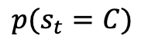
Markov chain: application
Imagine that these are three webpages of a e-commerce website and you record how usually people move through the website
Page C is the pay page, and you want to see how often people end up in that page
$$p(s_{t}=C)$$
for a very large t
let’s start by computing s₂? given that visitors start either from
a or b: p(s₁ = a) = p(s₁ = b) = 1/2

Slide 22
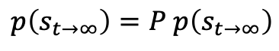
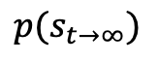
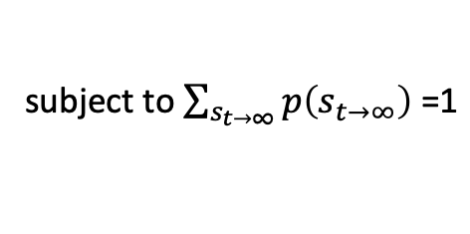
Markov chain: application
Imagine that these are three webpages of a e-commerce website and you record how usually people move through the website
Page C is the pay page, and you want to see how often people end up in that page
this is known as the stationary distribution if the transition does not affect it
$$p(s_{t→∞})$$
$$p\left(s_{t→∞}\right)=P p\left(s_{t→∞}\right)$$
subject to $\sum_{s_{t→∞}}{p\left(s_{t→∞}\right) \text{=1}}$

Slide 23
Markov chain: application
Imagine that these are three webpages of a e-commerce website and you record how usually people move through the website
Page C is the pay page, and you want to see how often people end up in that page
a key insight from markov theory is that it doesn’t matter where you start
this is known as the stationary distribution if the transition does not affect it
$$p(s_{t→∞})$$
$$p\left(s_{t→∞}\right)=P p\left(s_{t→∞}\right)$$
subject to $\sum_{s_{t→∞}}{p\left(s_{t→∞}\right) \text{=1}}$

Slide 24
Markov chain: application
Imagine that these are three webpages of a e-commerce website and you record how usually people move through the website
Page C is the pay page, and you want to see how often people end up in that page
a key insight from markov theory is that it doesn’t matter where you start
this is known as the stationary distribution if the transition does not affect it
$$p(s_{t→∞})$$
we can also find this distribution through simulation
$$p\left(s_{t→∞}\right)=P p\left(s_{t→∞}\right)$$
subject to $\sum_{s_{t→∞}}{p\left(s_{t→∞}\right) \text{=1}}$

Slide 25
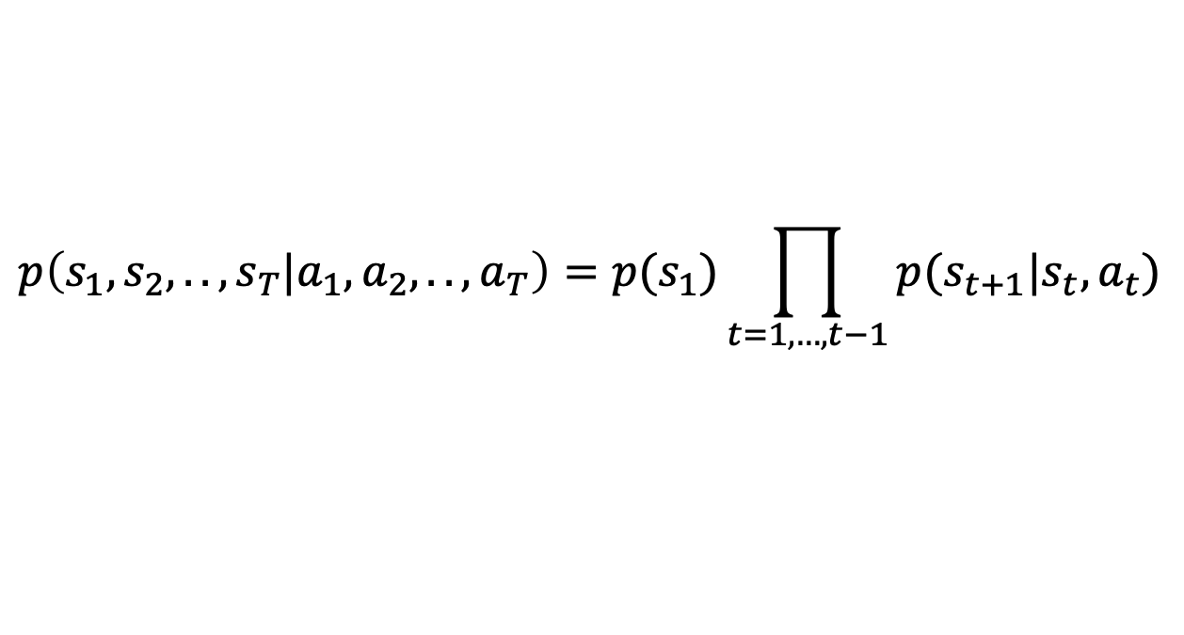
Markov Decision Process
Sometimes, we can make decisions at each state. This is called a controllable Markov chain
In tic-tac-toe, how many actions does one player have?
$$p\left(s_{1},s_{2},..,s_{T}|a_{1},a_{2},..,a_{T}\right)=p(s_{1})\prod_{t=1,…,t−1}{p(s_{t+1}|s_{t},a_{t})}$$

Slide 26
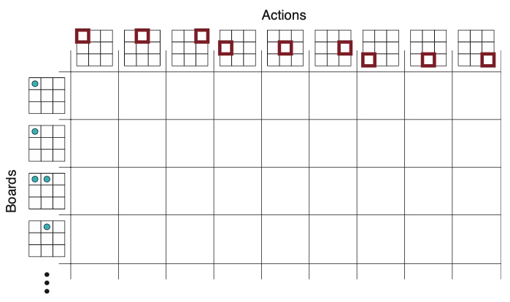
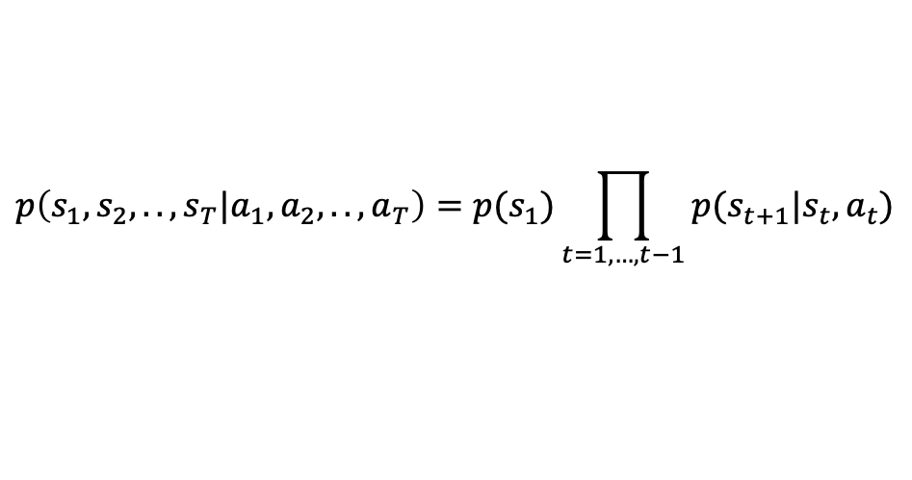
Markov Decision Process
Tic-tac-toe: let’s assume we are player X and we are playing against player O
$$p\left(s_{1},s_{2},..,s_{T}|a_{1},a_{2},..,a_{T}\right)=p(s_{1})\prod_{t=1,…,t−1}{p(s_{t+1}|s_{t},a_{t})}$$

Slide 27
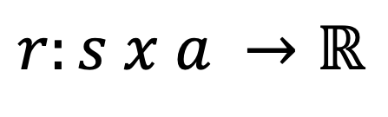
Markov Decision Process
In a Markov Decision Process (MDP), we further have stochastic rewards associated with each state-action pair
In the case of tic-tac-toe, we only receive reward if we make a winning move.
How would that look like?
$$r:s x a →ℝ$$

Slide 28
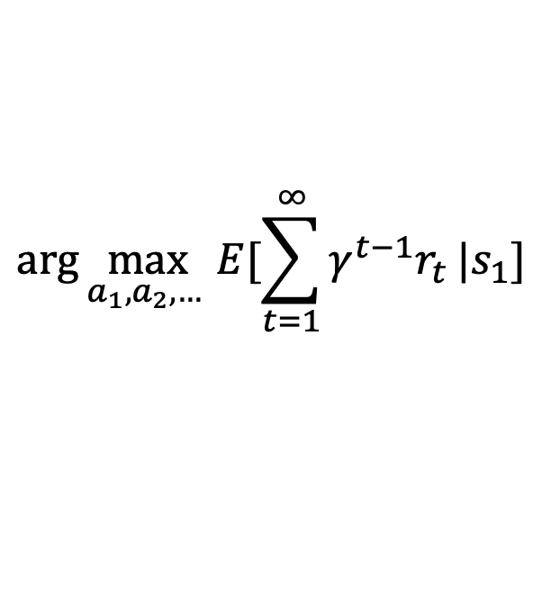
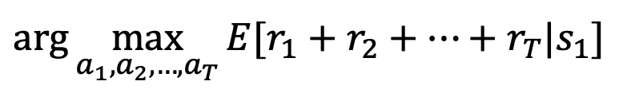
Markov Decision Process
In an MDP, we are looking to maximize our total reward if we are in a given state
Sometimes, we play infinite games, so we need the sum to converge through a discount factor
$$\arg{\max_{a_{1},a_{2},…,a_{T}}{E[r_{1}+r_{2}+…+r_{T}|s_{1}] }}$$
$$\arg{\max_{a_{1},a_{2},… }{E[\sum_{t=1}^{∞}{γ^{t−1}r_{t}}|s_{1}] }}$$

Slide 29
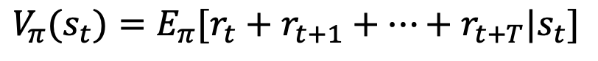
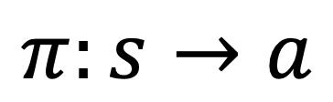
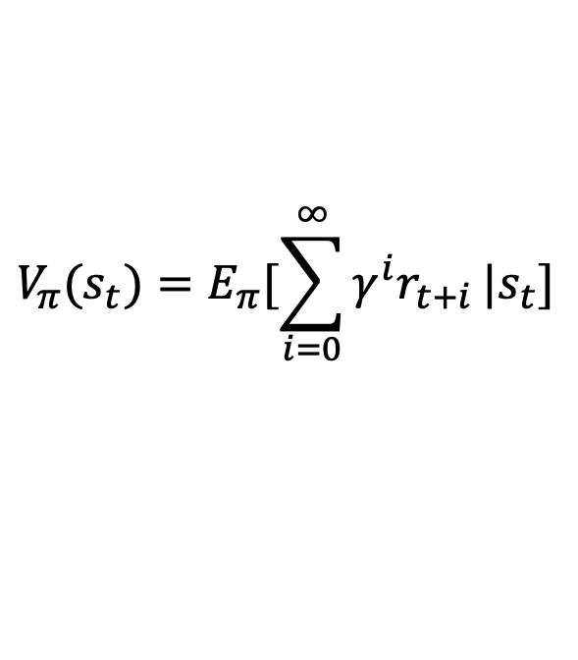
Markov Decision Process: Policy
Sometimes, someone gives a policy function of what to do in a given state
We can evaluate how good our policy is by computing its value
$$π:s→a$$
$$V_{π}(s_{t})=E_{π}[r_{t}+r_{t+1}+…+r_{t+T}|s_{t}]$$
$$V_{π}(s_{t})=E_{π}[\sum_{i=0}^{∞}{γ^{i}r_{t+i}}|s_{t}]$$
or

Slide 30
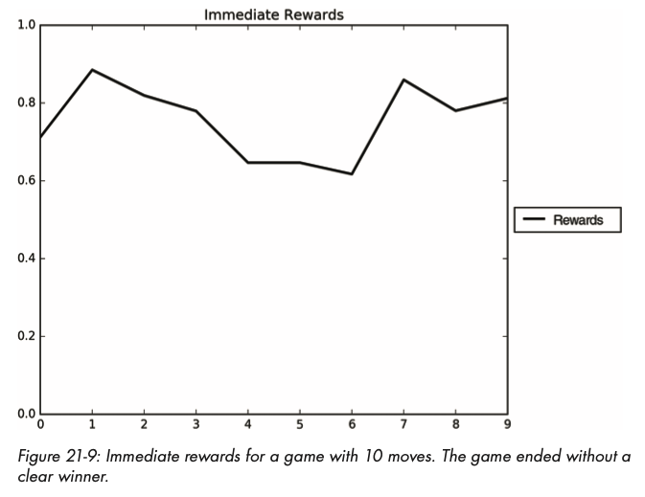
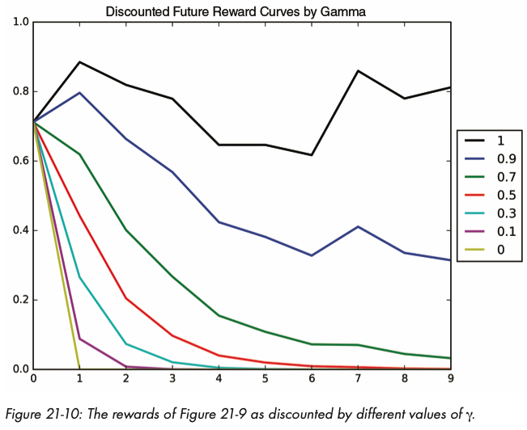
Disocunted rewards

Slide 31
Markov Decision Process: Policy
Sometimes, someone gives a policy function of what to do in a given state
There is another similar function called Q value, which defines the value of a specific action
$$π:s→a$$
$$Q_{π}(s_{t},a)=E_{π}[r_{t}+r_{t+1}+…+r_{t+T}|s_{t},a_{t}=a]$$

Slide 32
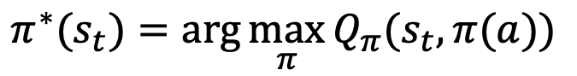
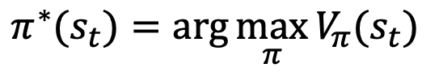
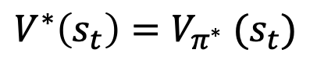
Markov Decision Process: Optimal Policy
Finally, we can define the optimal policy as the policy with maximum expected reward or discounted reward
Or with Q values
The optimal value is then the value of the optimal policy
$$π^{∗}(s_{t})=\arg{\max_{π}{V_{π}(s_{t})}}$$
$$π^{∗}(s_{t})=\arg{\max_{π}{Q_{π}(s_{t},π(a))}}$$
$$V^{∗}\left(s_{t}\right)=V_{π^{∗}} (s_{t})$$

Slide 33
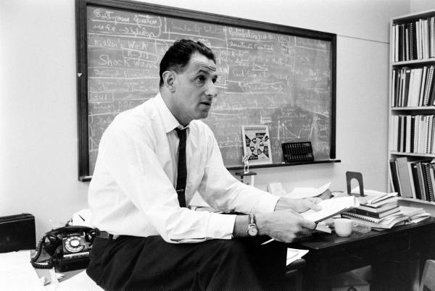
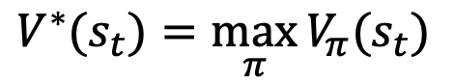
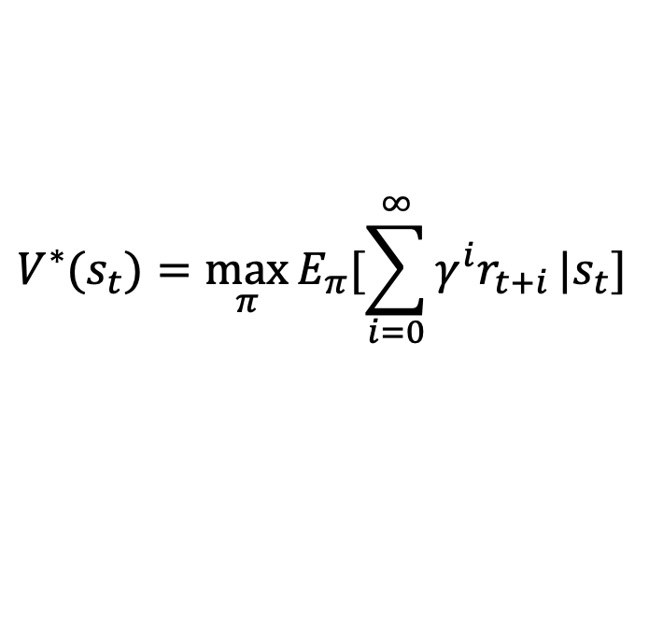
Markov Decision Process: Optimal Policy
Richard Bellman proved a seemgly simple fact about computing optimal policies:
the optimal policy takes the action with maximum reward today and follows the optimal policy tomorrow
$$V^{∗}(s_{t})=\max_{π}{V_{π}(s_{t})}$$
$$V^{∗}(s_{t})=\max_{π}{E_{π}[\sum_{i=0}^{∞}{γ^{i}r_{t+i}}|s_{t}]}$$
Richard Bellman
$$V^{∗}(s_{t})=\max_{a}{ \left\{r\left(s_{t},a\right)+γE[V^{∗}(s_{t+1})|a_{t}=a]\right\}}$$

Slide 34
Markov Decision Process: Optimal Policy
Richard Bellman proved a seemgly simple fact about computing optimal policies:
the optimal policy takes the action with maximum reward today and follows the optimal policy tomorrow
$$V^{∗}(s_{t})=\max_{π}{V_{π}(s_{t})}$$
$$V^{∗}(s_{t})=\max_{π}{E_{π}[\sum_{i=0}^{∞}{γ^{i}r_{t+i}}|s_{t}]}$$
Richard Bellman
$$V^{∗}(s_{t})=\max_{a}{ \left\{r\left(s_{t},a\right)+γE[V^{∗}(s_{t+1})|a_{t}=a]\right\}}$$

Slide 35
Bellman’s equation
The importance of the Bellman equation
is that it transforms a factorial space (all possible policies) into a multiplicative space (best action today)
Bellman proposed a method to find such policy very efficiently
$$V^{∗}(s_{t})=\max_{a}{ \left\{r\left(s_{t},a\right)+γE[V^{∗}(s_{t+1})|a_{t}=a]\right\}}$$

Slide 36
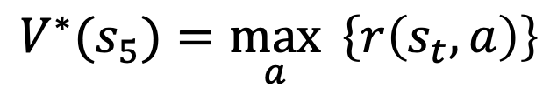
Bellman’s equation
Dynamic programming (it is not dynamic and it is not programming ☺)
We start from the end, and work our way backwards
Say for T = 5, the best decision at t = 5 is simply the best action
$$V^{∗}(s_{5})=\max_{a}{ \left\{r\left(s_{t},a\right)\right\}}$$
$$V^{∗}(s_{4})=\max_{a}{ \left\{r\left(s_{4},a\right)+γE[V^{∗}(s_{5})|a_{t}=a]\right\}}$$
…

Slide 37
Dynamic programming
DP makes solving Bellman’s equation very easy
It also has multiple applications beyond optimal value estimation
Classic problem: matrix multiplication order
A B C D

Slide 38
Dynamic programming (2)
Classic problem: matrix multiplication order
For example, multiplying three matrices 10 by 3, 3 by 5 and 5 by 2, we have two options:
(A B) C or
A (B C)
Which order produces the least computation?
Multiplying matrix would produce rows₁ * cols₁ * cols₂ operations, so order matter.
A B C D

Slide 39
Dynamic programming (2)
Multiplying matrix would produce rows₁ * cols₁ * cols₂ operations, so order matter.
The “state” is the location of current parentheses
Our “action” is to decide where to put a new parenthesis in between, and the “reward” is the negative of the number of operations
All possible parenthesis locations is exponential, but with DP the solution is quadratic
A B C D

Slide 40
Dynamic programming (2)
We start from the “end”
We cannot really do any action in these states and there is no multiplication, therefore the reward is zero
The only action is to put a parenthesis in the middle and the cost is simply rows₁ * cols₁ * cols₂ plus the cost of the subproblems
(A)
(B)
(C)
(D)
or
or
or
(A B)
(B C)
(C D)
or
or

Slide 41
Dynamic programming (2)
Now it the fun part!
We already have the optimal costs of these parenthesizations!
The only action is to put a parenthesis in the middle and the cost is simply rows₁ * cols₁ * cols₂ plus optimal reward of the subproblems, which we already have!
(A B)
(B C)
(C D)
or
or
(A B C)
or
(B C D)

Slide 42
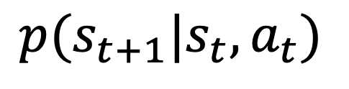
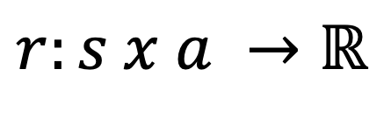
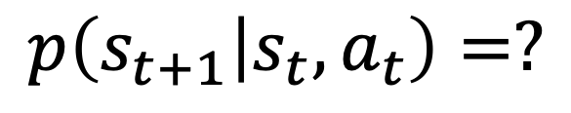
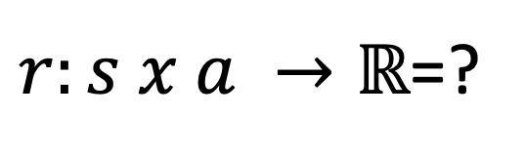
Back to reinforcement learning
Reinforcement Learning is the problem of finding the optimal value of actions for a Markov Decision Process for which we do not know the reward function or the probability distributions
MDP
RL
$$p(s_{t+1}|s_{t},a_{t})$$
$$p\left(s_{t+1} | s_{t},a_{t}\right)=?$$
$$r:s x a →ℝ$$
$r:s x a →ℝ$=?

Slide 43
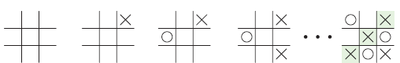
Reinforcement Learning in Action
Let’s see the steps involved in using reinforcement learning to teach a program how to play tic-tac-toe (Xs and Os).
To play, the players alternate placing an X or O in the cells of a three by three grid, and the first to get three of their symbols in a row (in any direction)
Deep Learning: A Visual Approach © 2021 by Andrew Glassner

Slide 44
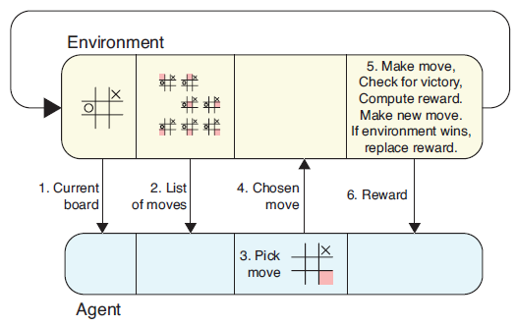
Reinforcement Learning in Action
In this scenario, the program we’re training is the agent. It’s playing against the environment, against another program that knows all about the game and how to play.
The agent doesn’t know the rules of the game, how to win or lose, or even how to make moves
At the start of each of the agent’s turns, the environment gives it two important pieces of information: the current board, and the list of available moves. This is shown in Steps 1
and 2 of Figure
In Step 3, the agent picks a move, based on any methodology it likes. Once the agent picks a move, it communicates that to the environment in Step 4. The environment then follows Step 5, by making the move by placing an X in the chosen cell.
Deep Learning: A Visual Approach © 2021 by Andrew Glassner

Slide 45
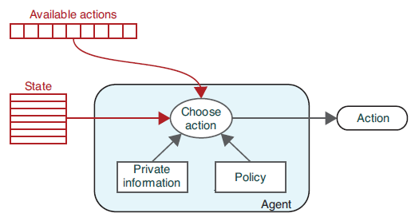
The Structure of Reinforcement Learning Step 1: The Agent Selects an Action
The agent then chooses an action from the list of actions we give it using an algorithm
called its policy, along with whatever private information the agent may have access to (including what it’s learned from previous episodes). Private information as a database.
The agent simply tells the environment what it wants to do, and the environment tries
to make that happen, maintaining the state so it’s always a correct picture of the current situation.
The environment provides the agent with the current world state and a choice of actions. The agent chooses an action and communicates that to the environment.
The policy, by contrast, is an algorithm that is usually controlled by a set of parameters. The parameters usually change over time as the agent plays and searches for improved action-choosing policies.
Deep Learning: A Visual Approach © 2021 by Andrew Glassner

Slide 46
The Structure of Reinforcement Learning Step 1: The Agent Selects an Action
At the start of training, we place the environment into an initial state. In a board game, this is the setup for the start of a new game. In our elevator example, this might be placing all elevator cars on the ground floor.
A full training cycle (such as a game from start to finish) is called an episode. We generally expect to teach the agent over a great many episodes
The environment provides the agent with the current world state and a choice of actions. The agent chooses an action and communicates that to the environment.
Recall that the environment is the world in which all of our agent’s actions take place. The environment is completely described by a set of numbers that are collectively called the environmental state, the state variables, or simply the state. The state is commonly made up of the position of all the markers on the board, plus any game assets (such as game money, power-ups, hidden cards, etc.) held by each player.
Deep Learning: A Visual Approach © 2021 by Andrew Glassner

Slide 47
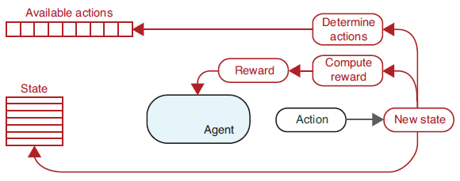
The Structure of Reinforcement Learning Step 2: The Environment Responds
In this step, the environment processes the agent’s action to produce a new state and processes the information that follows from this change.
The environment saves its new state in the state variables, so that they reflect the new environment when the agent next gets to choose an action.
Step 2 of our reinforcement learning process. This step starts with the computation of the new state (far right).
Both the state and the available actions are entirely replaced by their new versions. Lastly, the environment provides a reward signal that tells the agent how “good” its last chosen action was.
The meaning of “good” is completely dependent on what this whole system is doing. In a game, good actions are moves that lead to stronger positions or even victory
Deep Learning: A Visual Approach © 2021 by Andrew Glassner

Slide 48
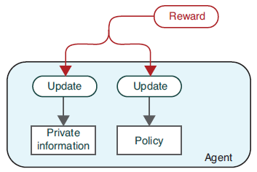
The Structure of Reinforcement Learning Step 3: The Agent Updates Itself
In this step, the agent uses the reward value to update its private information and policy parameters so that the next time this situation comes around, it is able to build on what it has learned from this choice.
After Step 3, the agent might wait quietly until the environment tells it that it’s time to take action again. Alternatively, it can immediately start planning for its next move.
Step 3 of our reinforcement learning process,
where the agent updates itself in response to the reward
Rather than simply stashing each reward into its private information, an agent usually processes that reward in some way to extract as much value from it as possible. This might even involve changing the values for other actions. For example, if we have just won a game and received an ultimate reward, we probably want to add a little bit of that reward to each of the moves that got us to victory.
The goal of reinforcement learning is to discover ways to help the agent in this scenario learn from the feedback to choose actions that bring it the best possible rewards
Deep Learning: A Visual Approach © 2021 by Andrew Glassner

Slide 49
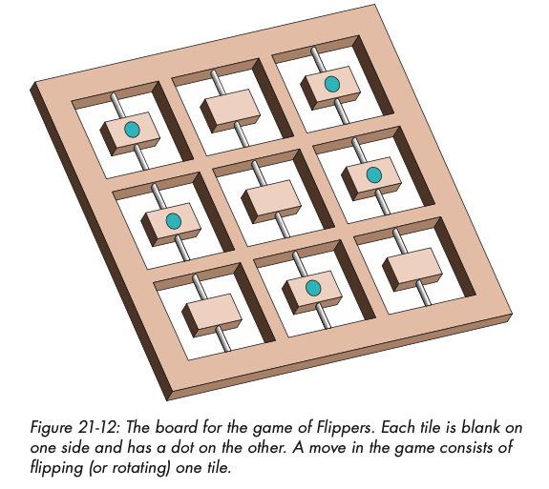
Flippers game
Create row or column with dots in the least number of steps.
There is some stochasticity

Slide 50
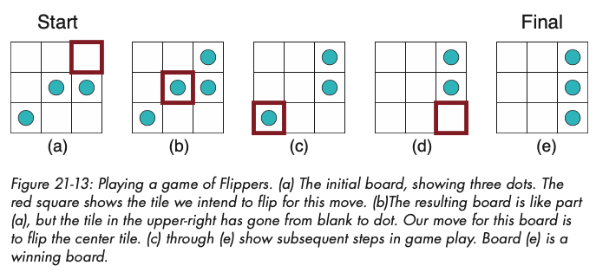
Flippers game

Slide 51
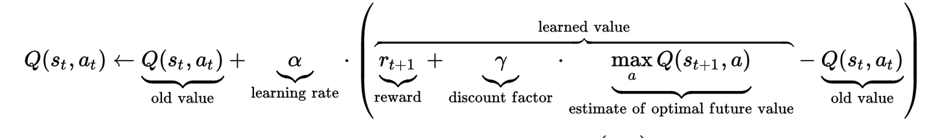
Q-learning
Q-learning

Slide 52
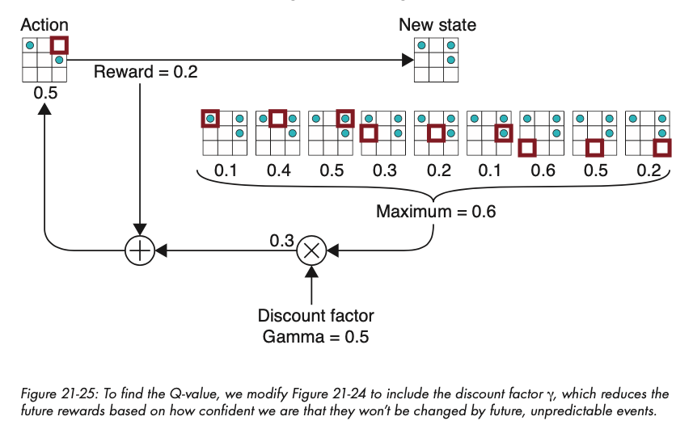
Q-learning (2)
Q-learning

Slide 53
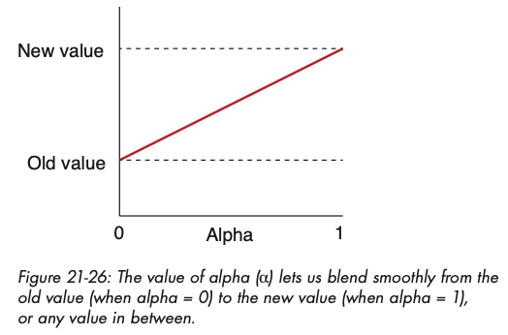
Q-learning (3)

Slide 54
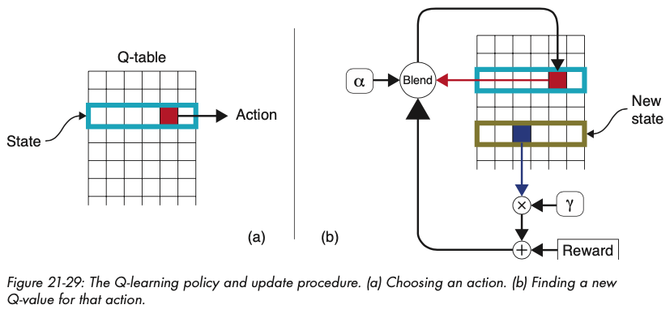
Q-learning (4)
Amazingly enough Watkins (Watkins & Dayan, 1992) show that it doesn’t matter our initial guess at the Q-table, it will converge to the optimal Q-values after exploring the environment

Slide 55
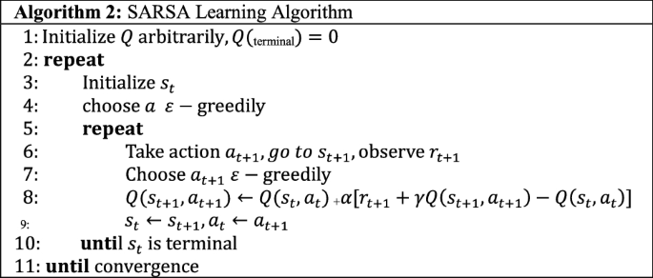
SARSA
Q-learning can be noisy. We can use a longer average by looking at actions after the next state

Slide 56
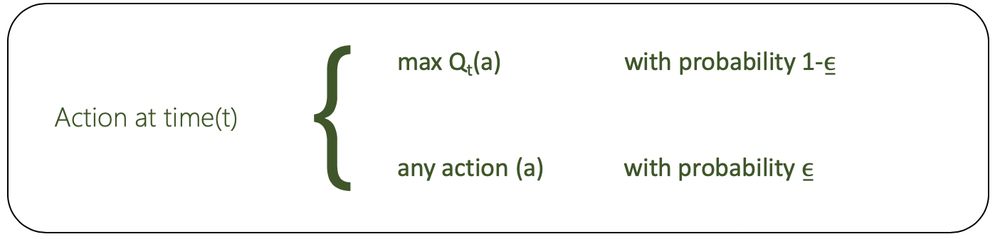
Q-learning and SARSA
Both algorithms require the agent to explore the environment
Decisions are made in a greedy manner based on current estimate of Q values but also with some randomness

Slide 57
Limitations of classic algorithms
States are usually discrete and small
If states grow too much, they are hard to explore
Classic problem of exploration and exploitation: you want to learn about the environment (explore) and at some point stick to the best possible actions without exploring (exploitation)

Slide 58
Limitations of classic algorithms
Although reinforcement learning was greatly inspired by animal behavior, the kinds of states, actions, and rewards used by the algorithms are simplistic
States, actions, and rewards are simple functions
In real life, state is highly dimensional, actions are unknown and continuous, and rewards are multi-dimensional

Slide 59
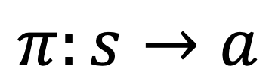
Limitations of classic algorithms
If we think about it, the agent is trying to learn a highly dimensional policy function
We could learn this function with a deep neural network
$$π:s→a$$

Slide 60
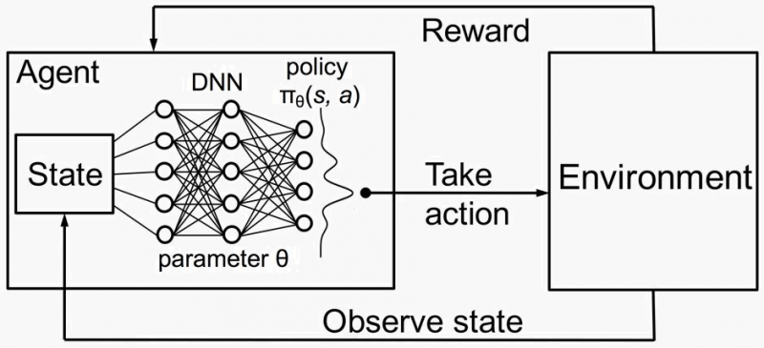
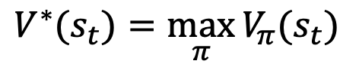
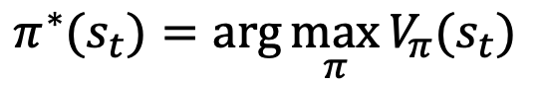
Deep Reinforcement Learning
More generally, we could try to learn both a deep neural network action function or a deep learning value function
$$V^{∗}(s_{t})=\max_{π}{V_{π}(s_{t})}$$
$$π^{∗}(s_{t})=\arg{\max_{π}{V_{π}(s_{t})}}$$

Slide 61


Deep Reinforcement Learning
The Bellman equation
can solved by simulation through value iteration similar to estimating stationary distribution of Markov Chain
for many iterations

Slide 62

Deep Reinforcement Learning
The Bellman equation
can solved by simulation through value iteration similar to estimating stationary distribution of Markov Chain
for many iterations
Value iteration is impractical because of large state spaces and little generalization. We can approximate the Q-value with a function
And then we can try to iteratively approximate Q_{i+1}

Slide 63
Deep Reinforcement Learning
DQN: Deep Q-network Define a neural network to approximate the function
Because it is differentiable, we can compute the gradient

Slide 64


Deep Reinforcement Learning
Now, states and action can be anything
Mnih, V., Kavukcuoglu, K., Silver, D., Rusu, A. A., Veness, J., Bellemare, M. G., ... & Hassabis, D. (2015). Human-level control through deep reinforcement learning. Nature, 518(7540), 529-533.

Slide 65

Deep Reinforcement Learning

Slide 66


Deep Reinforcement Learning
Learning to walk
Obstacle avoidance

Slide 67

Deep Reinforcement Learning
Is this deep RL or no?
https://www.youtube.com/watch?v=fn3KWM1kuAw&t=2s

Slide 68

Deep Reinforcement Learning: Go
Silver, D., Huang, A., Maddison, C. J., Guez, A., Sifre, L., Van Den Driessche, G., ... & Hassabis, D. (2016). Mastering the game of Go with deep neural networks and tree search. Nature, 529(7587), 484-489.

Slide 69

Deep Reinforcement Learning: Chess

Slide 70

Deep Reinforcement Learning: Starcraft

Slide 71



Deep Reinforcement Learning: Multi-agents

Slide 72

Deep Reinforcement Learning: Dota 2

Slide 73
Conclusion
Reinforcement learning is one of the most general kinds of machine learning problems
It is highly applicable for building artificial agents that learn and act in unknown environments
Deep Learning has enabled the introduction of these agents to highly complex environments

